Slide 1
Module 4
Programmable interval timer 8254

Slide 2
8254 programmable interval timer
8254 is a device designed to solve the timing control problems in a microprocessor.
It has 3 independent counters, each capable of handling clock inputs up to 10 MHz, and size of each counter is 16 bit.
It operates in +5V regulated power supply and has 24 pin signals
All modes are software programmable
The 8254 is an advanced version of 8253 which did not offered the feature of read back command.

Slide 3
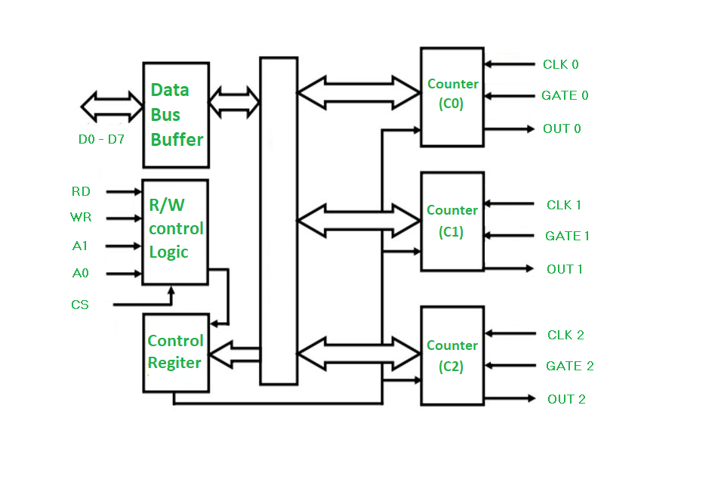
8254 Architecture

Slide 4
DATA BUS BUFFER: This 3-state, bi-directional, 8-bit buffer is used to interface the 8254 to the system bus
.READ/WRITE LOGIC : The Read/Write Logic accepts inputs from the system bus and generates control signals for the other functional blocks of the 8254.
A1 and A 0 select one of the three counters or the Control Word Register to be read from/written into. •
A “low” on the RD input tells the 8254 that the CPU is reading one of the counters

Slide 5
A “low” on the WR input tells the 8254 that the CPU is writing either a Control Word or an initial count.
Both RD and WR are qualified by CS; RD and WR are ignored unless the 8254 has been selected by holding CS low.
CONTROL WORD REGISTER :The Control Word Register is selected by the Read/Write Logic when A1,A0 = 11.
If the CPU then does a write operation to the 8254, the data is stored in the Control Word Register and is interpreted as a Control Word used to define the operation of the Counters.

Slide 6
The Control Word Register can only be written to; status information is available with the Read-Back Command.
COUNTER 0, COUNTER 1, COUNTER 2 :These three functional blocks are identical in operation, so only a single Counter will be described.
The Counters are fully independent. Each Counter may operate in a different Mode. •
The Control Word Register is not part of the Counter itself, but its contents determine how the Counter operates.

Slide 7
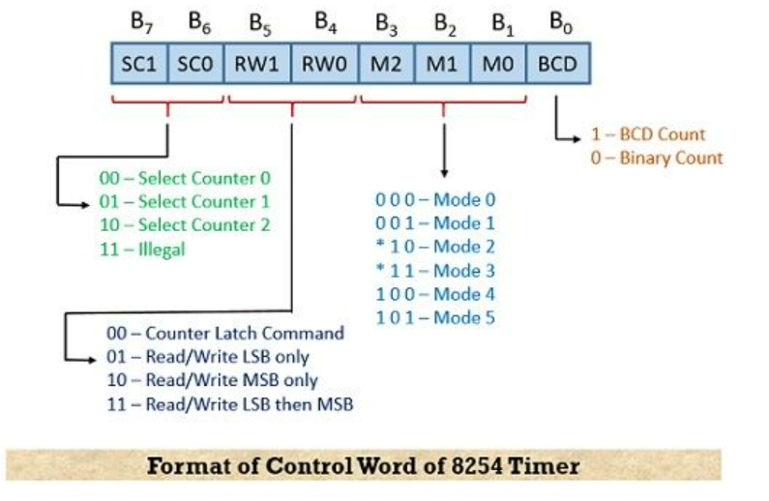
Programming of 8254

Slide 8
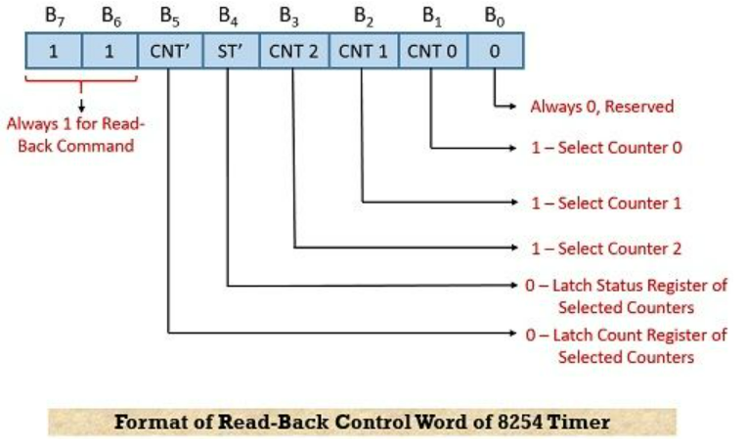

Slide 9
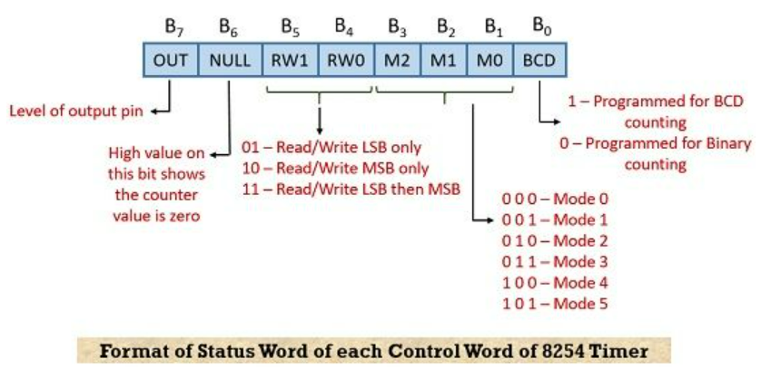

Slide 10
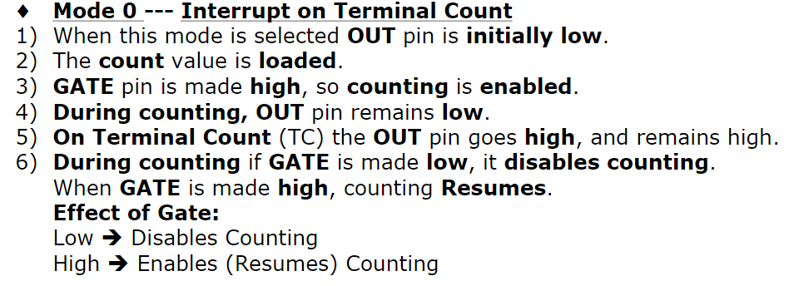
Timer modes of 8254
Mode 0:INTERRUPT ON TERMINAL COUNT :

Slide 11
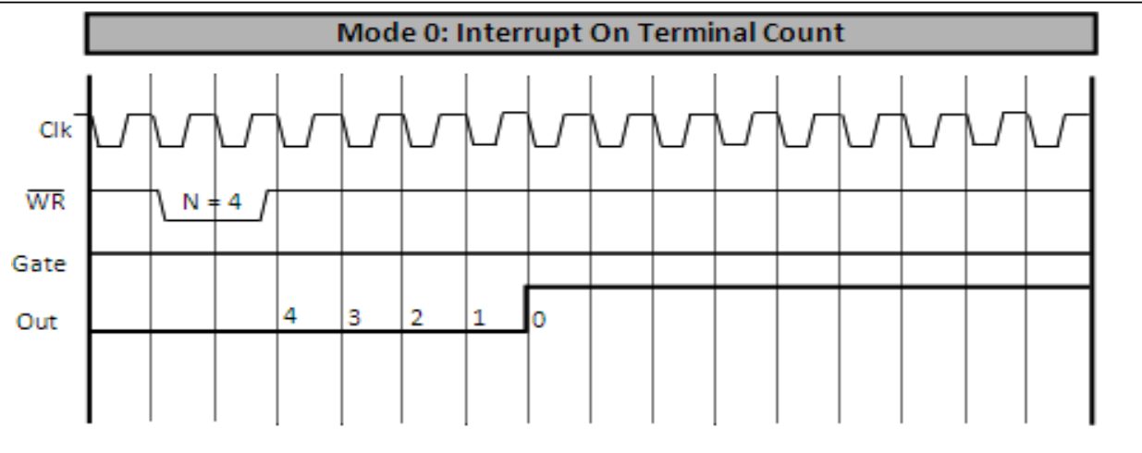

Slide 12
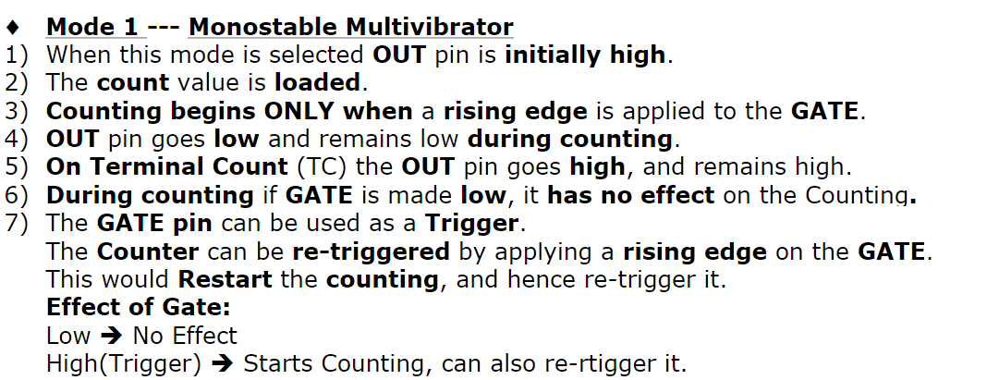

Slide 13
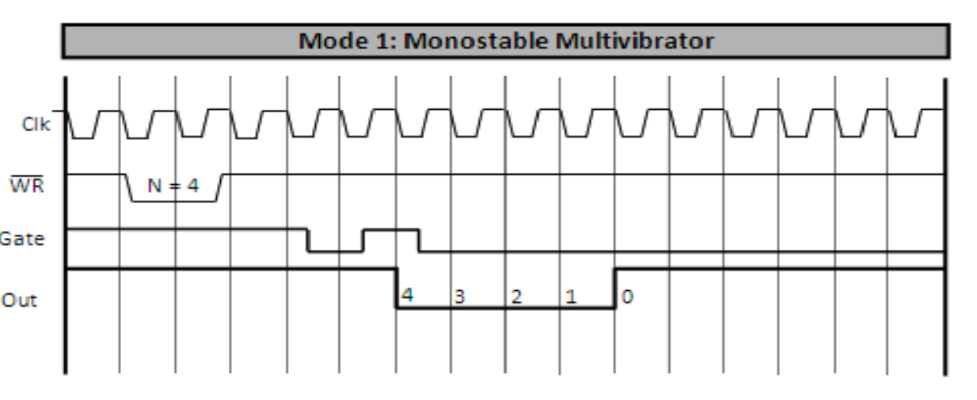

Slide 14
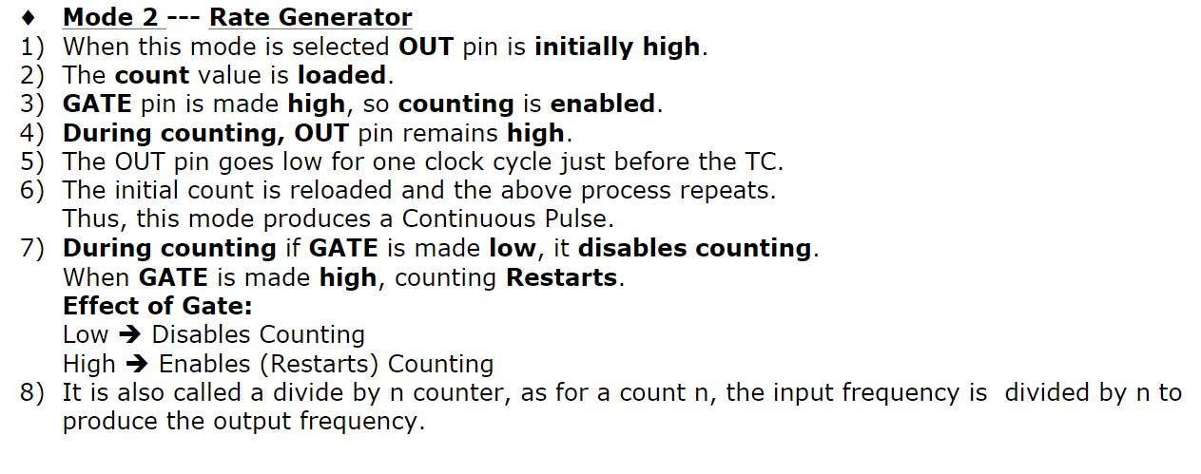

Slide 15
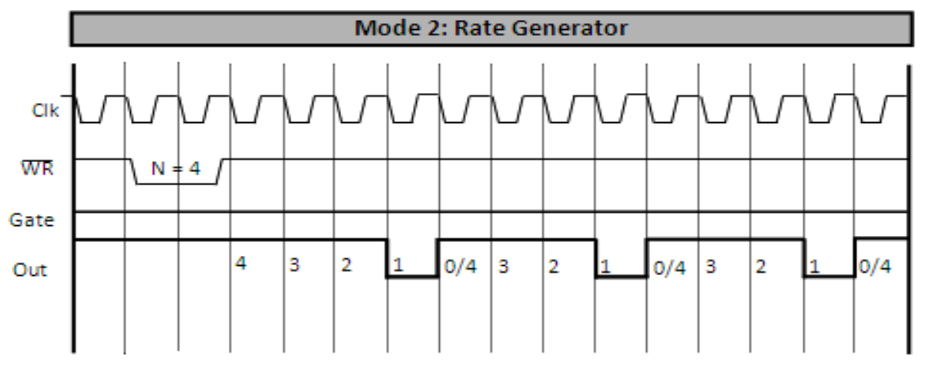

Slide 16
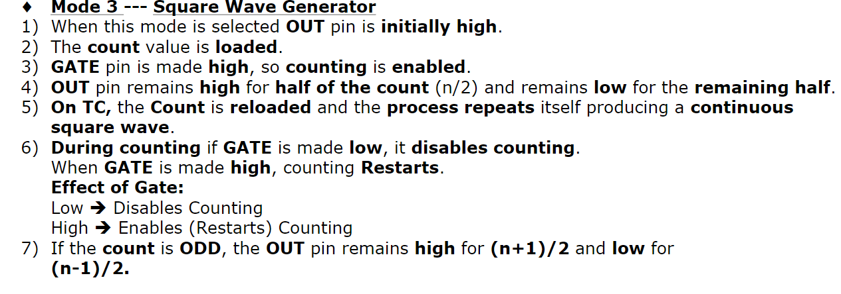

Slide 17
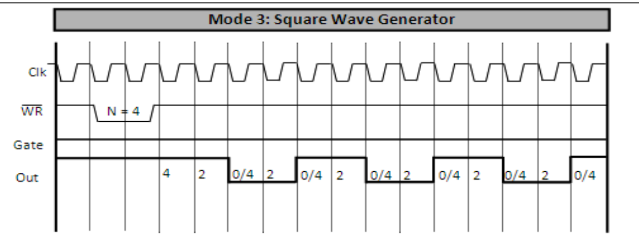

Slide 18
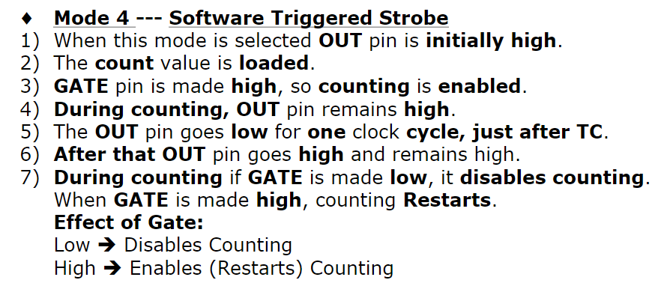

Slide 19
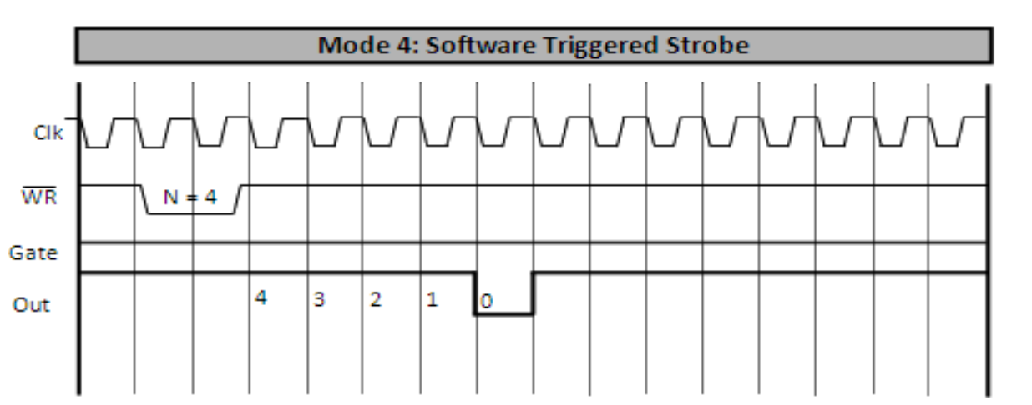

Slide 20
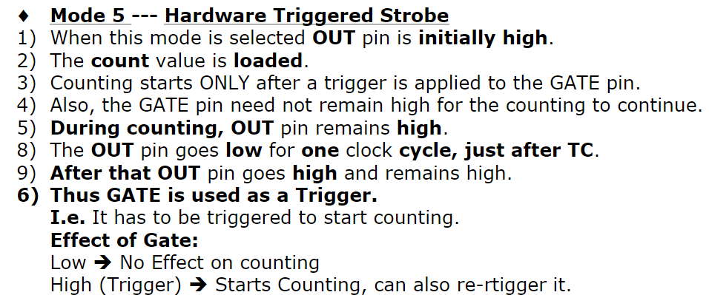

Slide 21
